Slide 2
Problem Solving and Programming
Dr Solomon Amos
ac8880@coventry.ac.uk
14th January, 2019

Slide 3
Week 1 Learning Objectives
Recognise the essential course documentation.
Pseudocode.
Boolean algebra and logic.
Programming language types and paradigms.
Introduction to Python.
Programming fundamentals.
Introduction to algorithms.

Slide 4
Day 1 Learning Objectives
Understand the following course documents:
Module Information Descriptor (MID)
Scheme of Work (Sow)
Essential & Recommended Reading List.
1st Assignment Brief
CU-Harvard referencing guides
Boolean algebra and logic.

Slide 5
Understand the course documents
Module Information Descriptor (MID)
Intended Module Learning Outcomes (MLOs)
Indicative Content
Reading List (Essential & Recommended)
Scheme of Work (SOW)
Subject matter taught for each session.
Assignment Brief (including template)
Requirement specifications for your assignment.

Slide 6
What ultimately matters in this course is not so much where you end up relative to your classmates but where you, in Week 6, end up relative to yourself in Week 1

Slide 7
Problem Solving
Notes:
The course itself ultimately is not about programming per se that is indeed a tool that we’ll use. It’s all about problem solving that is really interesting and that is what CS is generally. Whether you are interested in software development, graphics, AI, ML, hardware, theory etc. What is really interesting about CS is that its not an end to itself, its what empowers you to go do more interesting and powerful things in any field.

Slide 8
Problem Solving
Inputs
Outputs
Notes:
The course itself ultimately is not about programming per se, that is indeed a tool that we’ll use. It’s all about problem solving that is really interesting and that is what CS is generally. Whether you are interested in software development, cyber security, networking, graphics design, AI, ML, hardware, theory etc. What is really interesting about CS is that its not an end to itself, its what empowers you to go do more interesting and powerful things in any field.

Slide 9
123
Notes:
The course itself ultimately is not about programming per se, that is indeed a tool that we’ll use. It’s all about problem solving that is really interesting and that is what CS is generally. Whether you are interested in software development, cyber security, networking, graphics design, AI, ML, hardware, theory etc. What is really interesting about CS is that its not an end to itself, its what empowers you to go do more interesting and powerful things in any field.

Slide 10
ASCII
A B C D E F G H I ...
65 66 67 68 69 70 71 72 73 ...
Notes:
The course itself ultimately is not about programming per se, that is indeed a tool that we’ll use. It’s all about problem solving that is really interesting and that is what CS is generally. Whether you are interested in software development, cyber security, networking, graphics design, AI, ML, hardware, theory etc. What is really interesting about CS is that its not an end to itself, its what empowers you to go do more interesting and powerful things in any field.

Slide 11
ASCII
72 73 33
Notes:
The course itself ultimately is not about programming per se, that is indeed a tool that we’ll use. It’s all about problem solving that is really interesting and that is what CS is generally. Whether you are interested in software development, cyber security, networking, graphics design, AI, ML, hardware, theory etc. What is really interesting about CS is that its not an end to itself, its what empowers you to go do more interesting and powerful things in any field.

Slide 12
ASCII
H I !
72 73 33
1001000 1001001 100001
Notes:
The course itself ultimately is not about programming per se, that is indeed a tool that we’ll use. It’s all about problem solving that is really interesting and that is what CS is generally. Whether you are interested in software development, cyber security, networking, graphics design, AI, ML, hardware, theory etc. What is really interesting about CS is that its not an end to itself, its what empowers you to go do more interesting and powerful things in any field.

Slide 13
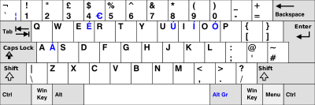
Abstraction
Notes:
The course itself ultimately is not about programming per se, that is indeed a tool that we’ll use. It’s all about problem solving that is really interesting and that is what CS is generally. Whether you are interested in software development, cyber security, networking, graphics design, AI, ML, hardware, theory etc. What is really interesting about CS is that its not an end to itself, its what empowers you to go do more interesting and powerful things in any field.

Slide 14

Abstraction
128514
11111011000000010
Unicode and UTF-8
Notes:
The course itself ultimately is not about programming per se, that is indeed a tool that we’ll use. It’s all about problem solving that is really interesting and that is what CS is generally. Whether you are interested in software development, cyber security, networking, graphics design, AI, ML, hardware, theory etc. What is really interesting about CS is that its not an end to itself, its what empowers you to go do more interesting and powerful things in any field.

Slide 15


RGB
=
Notes:
The course itself ultimately is not about programming per se, that is indeed a tool that we’ll use. It’s all about problem solving that is really interesting and that is what CS is generally. Whether you are interested in software development, cyber security, networking, graphics design, AI, ML, hardware, theory etc. What is really interesting about CS is that its not an end to itself, its what empowers you to go do more interesting and powerful things in any field.

Slide 16
Problem Solving
Inputs
Outputs
Notes:
The course itself ultimately is not about programming per se, that is indeed a tool that we’ll use. It’s all about problem solving that is really interesting and that is what CS is generally. Whether you are interested in software development, cyber security, networking, graphics design, AI, ML, hardware, theory etc. What is really interesting about CS is that its not an end to itself, its what empowers you to go do more interesting and powerful things in any field.

Slide 17
Problem Solving
ALGORITHMS
Inputs
Outputs
Notes:
Algorithms – Step by step instructions for solving some problems

Slide 18
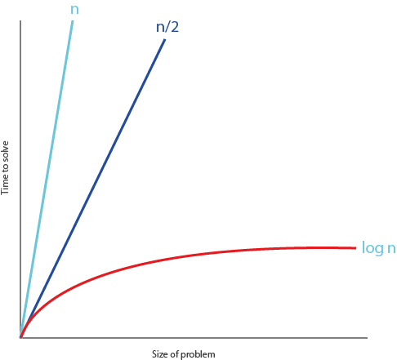
Problem Solving
Notes:
Algorithms – Step by step instructions for solving some problems

Slide 19
Pseudocode
0 pick up phone book
1 open to middle of phone book
2 look at names
3 if Smith is among names
4 call Mike
5 else if Smith is earlier in book
6 open to middle of left half of book
7 go back to step 2
8 else if Smith is later in book
9 open to middle of right half of book
10 go back to step 2
11 else
12 quit
0 pick up phone book
1 open to middle of phone book
2 look at names
3 if Smith is among names
4 call Mike
5 else if Smith is earlier in book
6 open to middle of left half of book
7 go back to step 2
8 else if Smith is later in book
9 open to middle of right half of book
10 go back to step 2
11 else
12 quit
Notes:
Algorithms – Step by step instructions for solving some problems

Slide 20
Pseudocode
0 pick up phone book
1 open to middle of phone book
2 look at names
3 if Smith is among names
4 call Mike
5 else if Smith is earlier in book
6 open to middle of left half of book
7 go back to step 2
8 else if Smith is later in book
9 open to middle of right half of book
10 go back to step 2
11 else
12 quit
0 pick up phone book
1 open to middle of phone book
2 look at names
3 if Smith is among names
4 call Mike
5 else if Smith is earlier in book
6 open to middle of left half of book
7 go back to step 2
8 else if Smith is later in book
9 open to middle of right half of book
10 go back to step 2
11 else
12 quit
Notes:
Algorithms – Step by step instructions for solving some problems

Slide 21
Pseudocode
0 pick up phone book
1 open to middle of phone book
2 look at names
3 if Smith is among names
4 call Mike
5 else if Smith is earlier in book
6 open to middle of left half of book
7 go back to step 2
8 else if Smith is later in book
9 open to middle of right half of book
10 go back to step 2
11 else
12 quit
Notes:
Algorithms – Step by step instructions for solving some problems

Slide 22
Program
We can write programs with the building blocks we just discovered:
Functions
Conditions
Boolean expressions
Loops
Variables
Threads
Events …
Notes:
Algorithms – Step by step instructions for solving some problems

Slide 23
Learning Activity 1
Learners to:
Work in pairs to create pseudo code for making a cup of tea/coffee. (20 mins)
Review to determine if there are any other alternative ways they could modify their pseudo code to accomplish the same goal. (20 mins)
Tutor to:
Provide one-to-one guidance and support to learners.

